Slide 1
ONLINE GROCERY APPLICATION
TEAM MEMBERS AND ENROLLMENT NUMBER :
LAKSHANA G - EBEON0322585493
NIVETHA M - EBNON0322582467
SELVAGANAPATHY B –EBEON0322584732
SURYA R - EBEON0322576846
AARATI - EONFWL583387
AKSHAY -
Guided by
A.Varadharajan. B.Tech,ME,MBA,MISTE,AIENGG

Slide 2
Project Modules
Admin Login
Add Products
Customer Registration
Customer Login
SSO(Single Sign On)
View Products
Add Cart
Payment Options
Chatbot
SMS

Slide 3
MODULES DESCRIPTION
Goal of Project :
Save time and travel expense to buy your daily needs.
One-click and handy shopping.
Provide facility to online payment
Provide an online platform for every customer.
List of My Module and Sub Module:
Customer Login
MYSQL connection with CURD operation
SSO
Google connection with OAuth Approach
View Product
MYSQL connection with CURD operation

Slide 4
Customer Login
Definition:
A customer login form is used by visitors to log in to their customer account page with security
purpose.
MYSQL connection with CURD operation:
Using an entity annotation ,getter and setter methods to approaching the CRUD Operations

Slide 5
SSO(SINGLE SIGN ON)
Definition:
Single sign-on (SSO) is an authentication method that enables users to securely authenticate with
multiple applications and websites by using just one set of credentials.
Google connection with OAuth Approach
OAuth allows users to share specific data with an application while keeping their usernames, passwords, and other information private.

Slide 6
View Product
Definition:
These views are for looking at individual products in the data product detail page.
MYSQL connection with CURD operation:
Using an entity annotation, getter and setter methods to approaching the CRUD Operations

Slide 7
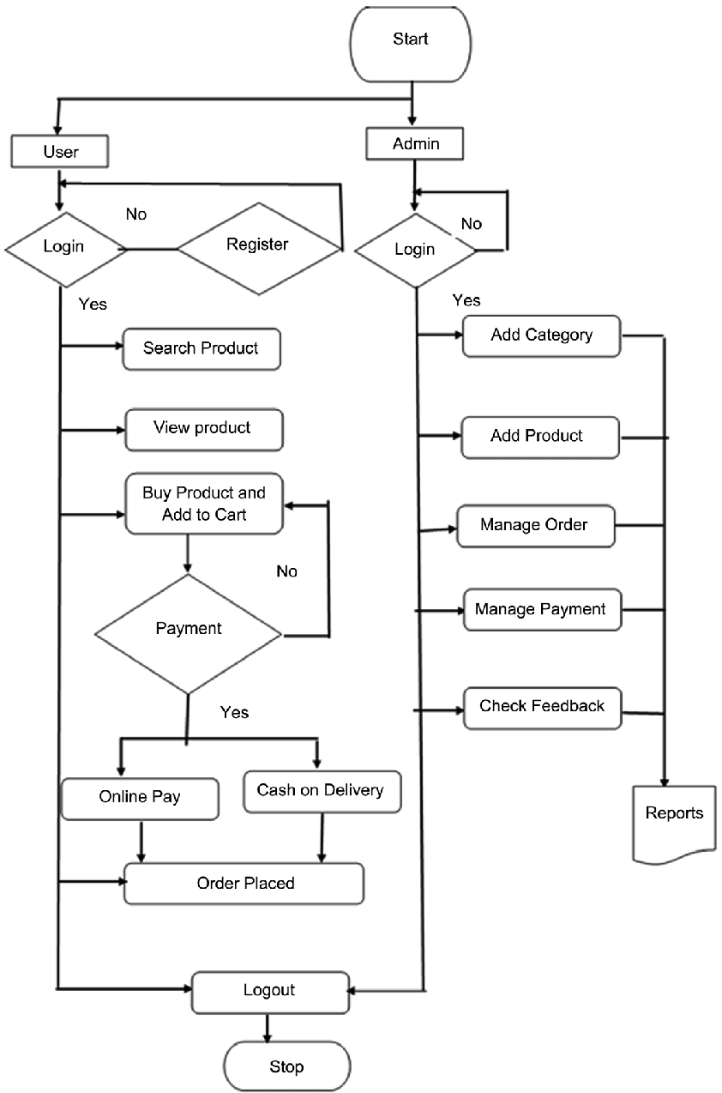
Project overview

Slide 8
Tech architecture
Embedded Servlet – Tomcat
Login – logback
OAuth
Twilio Communication
Html
CSS
JavaScript
Testing approach e2e
Spring Boot
Browser
Front End
Back End
Hibernate
DDL
DML
DCL
TCL
Mysql Workbench
Object persistence
Database Connection
Mapping with POJO

Slide 9
Dataflow Diagram
SSO
Admin Login
login
Customer login
Registration
Dashboard
login
Dashboard
shop
View Product
Add cart
cart
checkout
logout
Add Product
Add Category

Slide 10
Challenging Issues
White label Error
No Mapping found for HTTP request
Compilation failure [Error] or Build failure compiler is provided in this Environment
Server port issue

Slide 11
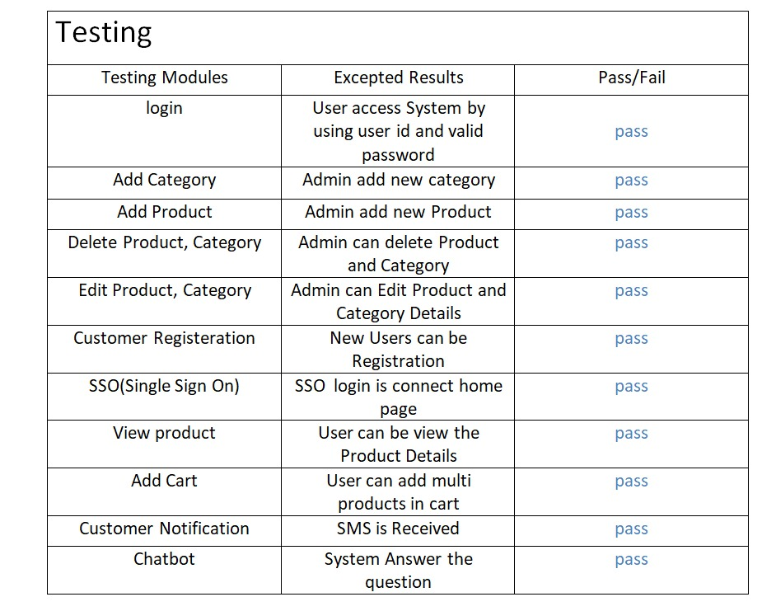
Testing
Manual Testing Result

Slide 12
Features about the module
Customer Login
Dashboard with activity updates
Communication Tools
Security
SSO
Easy management
Security

Slide 13
Future enhancement
The current system can be extended to allow the users to create accounts and save products in to wish list.
The users could subscribe for price alerts which would enable them to receive messages when price for products fall below a particular level.
The current system is confined only to the shopping cart process. It can be extended to have an easy to use check out process.
Users can have multiple shipping and billing information saved. During checkout they can use the drag and drop feature to select shipping and billing formation

Slide 14
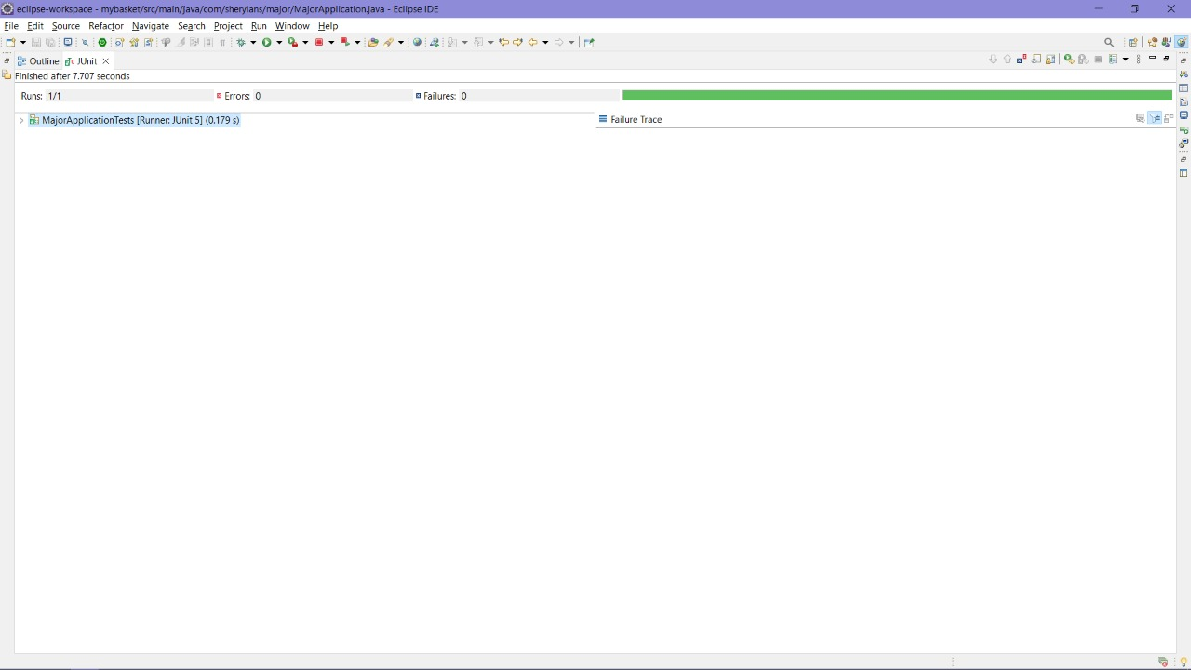
DevOps tools approach
Junit Testing Tool
Maven
Github
Mysql Workbench
Tomcat

Slide 15
Conclusion
The ‘Online Shopping’ is designed to provide a web based application that would make searching, viewing and selection of a product easier. The search engine provides an easy and convenient way to search for products where a user can Search for a product interactively and the search engine would refine the products available based on the user’s input. The user can then view the complete specification of each product. They can also view the product reviews and also write their own reviews. Use of Ajax components would make the application interactive and prevents annoying post backs. Its drag and drop feature would make it easy to use.

